Slide 1
Functional Programming in Java 8 - Part 3 - Java Streams - Introduction
Stav Alfi

Slide 2
Pre Requirements
Basic knowledge in Java
Basic knowledge in Java templates
Thorough understanding about lambda expressions

Slide 3
Agenda
Motivation
What is a stream
Basic operations
Questions

Slide 4

Motivation
Declarative code
Processing only what you need
Parallel programming
Start thinking “Async”
Controlling the callbacks hell
It’s standard

Slide 5
What is a stream
“Processing Data using a pipeline by intermediate and terminal operations.”
Stav Alfi 2017

Slide 6
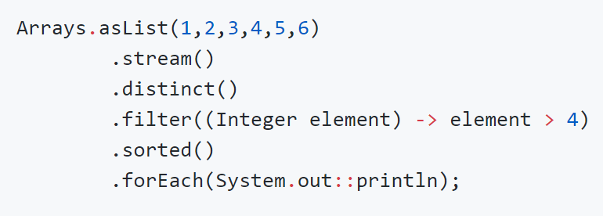
What is a stream
Intermediate Operations
Terminal Operation

Slide 7
What is a stream
Pipeline
Multiple intermediate operations
A single terminal operation

Slide 8
Basic operations
forEach
map
filter
peek
distinct
sorted
Limit
Exercises + short break

Slide 9
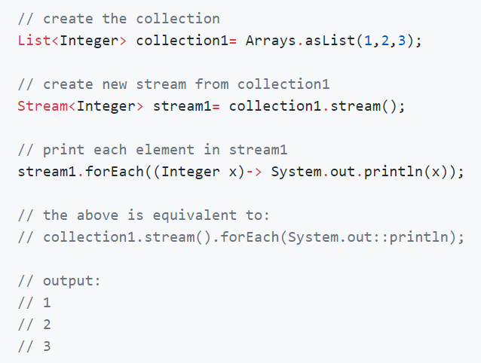
Basic operations - forEach

Slide 10
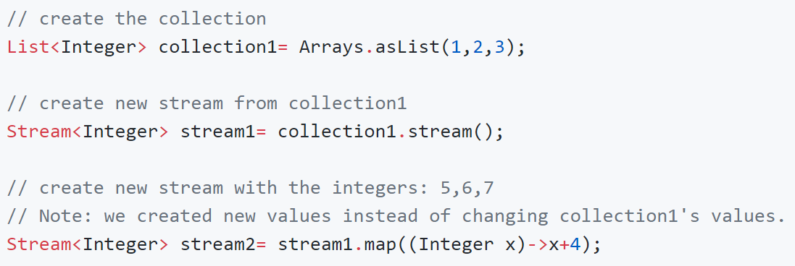
What will happen?
Basic operations - map

Slide 11
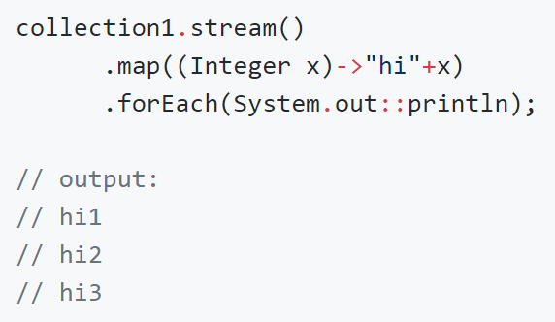
Basic operations - map

Slide 12
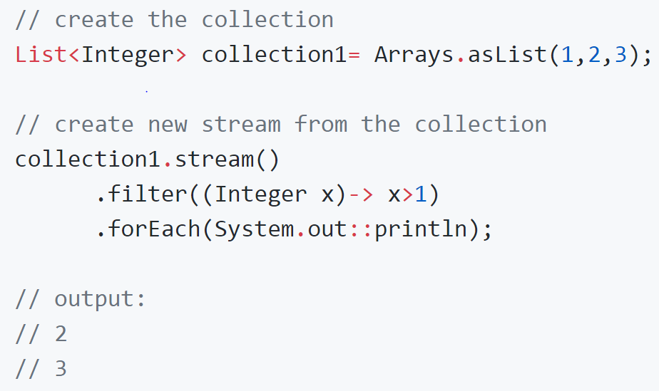
Basic operations - filter

Slide 13
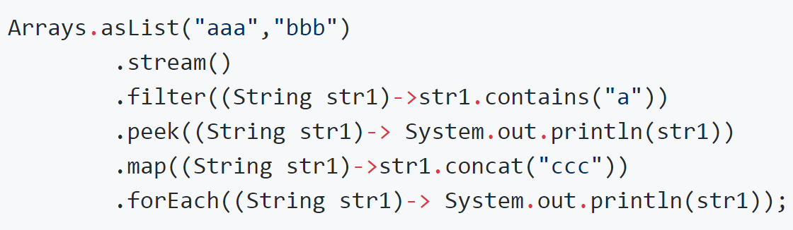
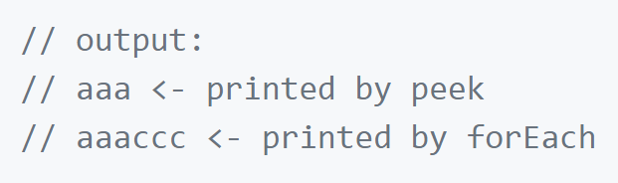
Basic operations - peek

Slide 14
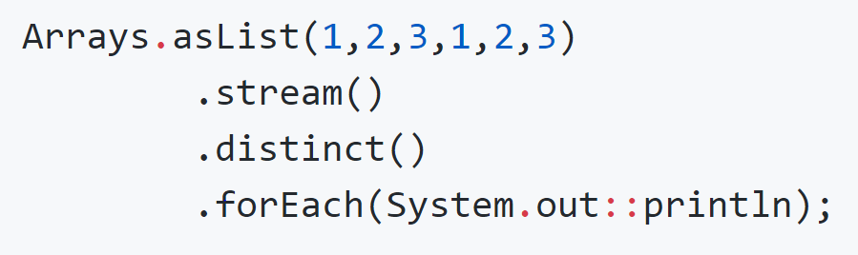
Basic operations - distinct
The elements we distinct, must implement equals(Object) method

Slide 15
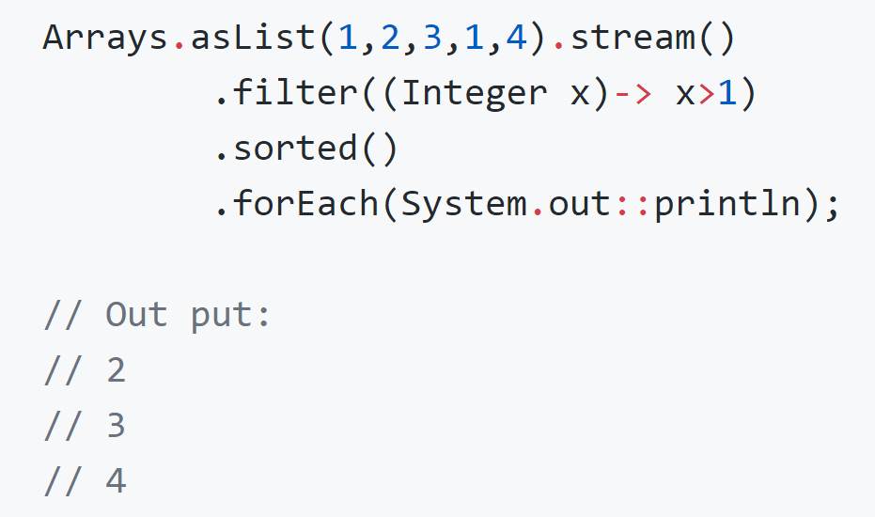
Basic operations - sorted
The type of the elements we sort, must implement Comparable interface

Slide 16
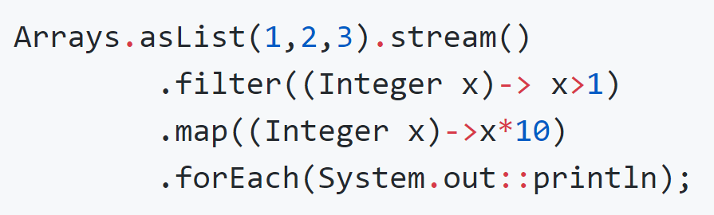
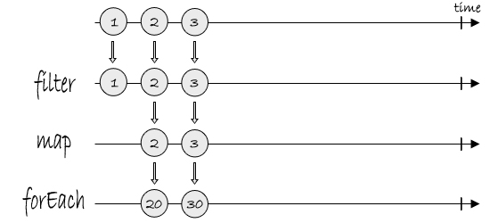
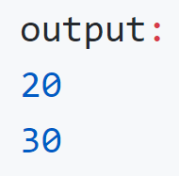
You were living in a lie…

Slide 17
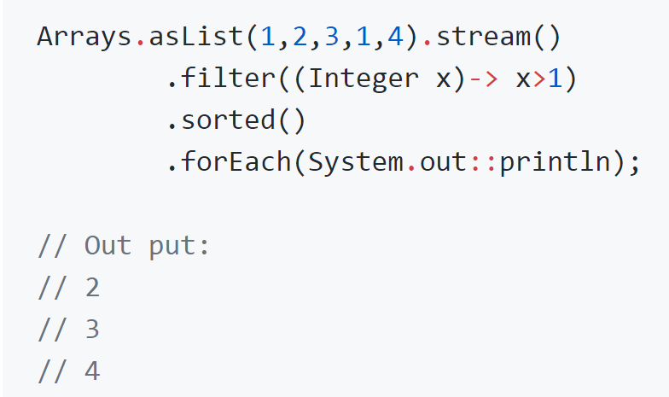
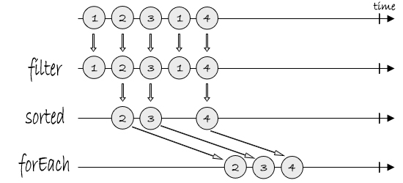
You were living in a lie…

Slide 18
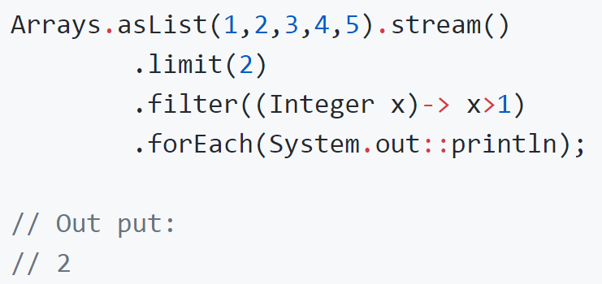
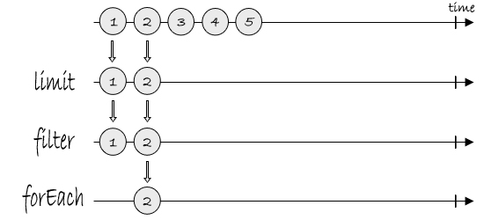
Basic operations - limit

Slide 19
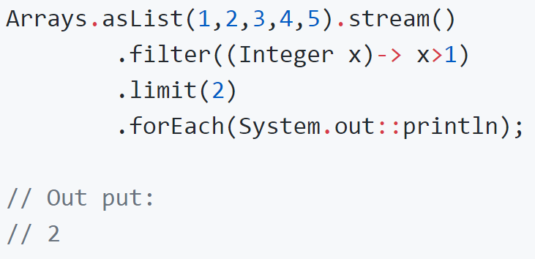
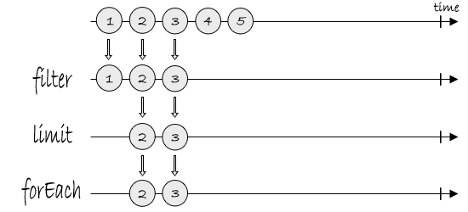
Basic operations - limit
3

Slide 20
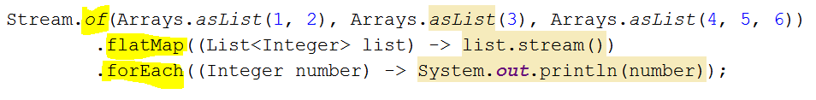
FlatMap operation - Basics

Slide 21
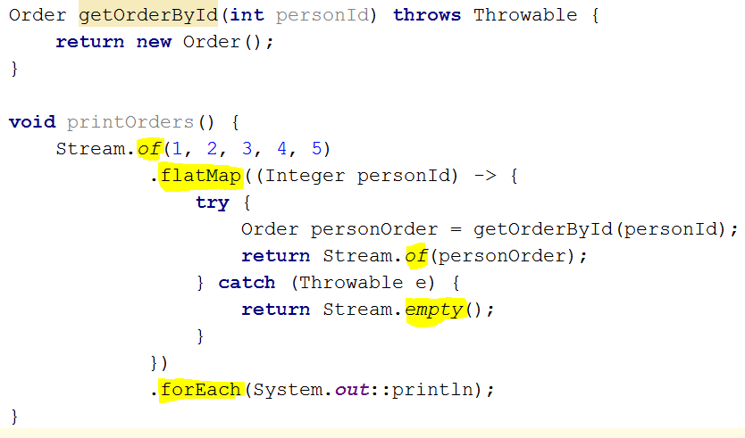
FlatMap operation – Real Example – V1

Slide 22
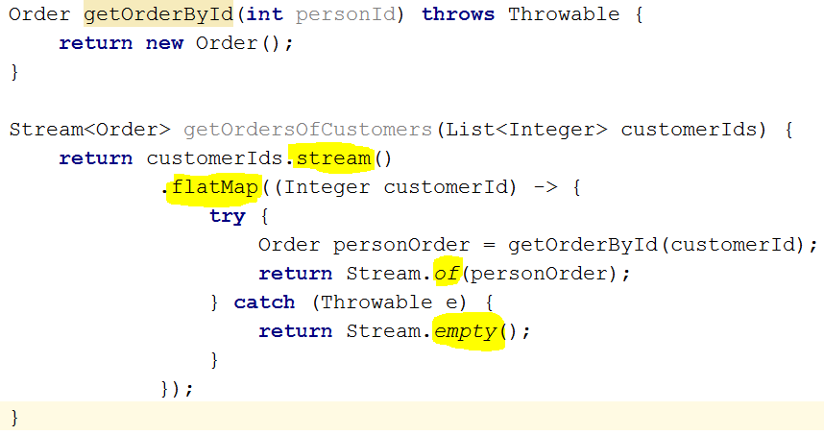
FlatMap operation – Real Example – V2

Slide 23
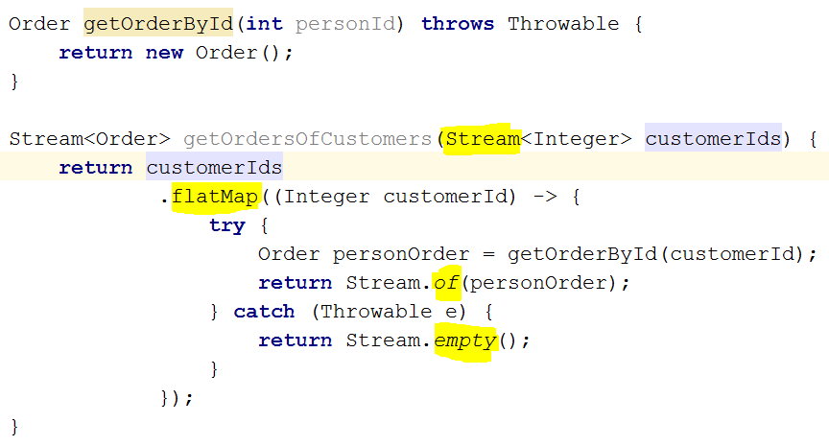
FlatMap operation – Real Example – V3

Slide 24
Native solutions for Async streams in Java
Amount of elements/Is Async | Synchronous | Async
0...1 | Future Optional | CompletableFuture
0…Infinity | Java Streams | Reactive Streams
Session 4
Session 5
Session 3

Slide 25
Exercises
Print all the even numbers in [1,10]
Create Person class with the following properties: ID, age, B.D.
Create a fake method which return a Person object by ID.
Create a fake method which update a Person details by ID.
Given list of IDs (not distinct IDs), get each Person object related to that ID from a server, if his B.D is today then update each age to age+1. Print the Ids of the person you updated their age.

Slide 26
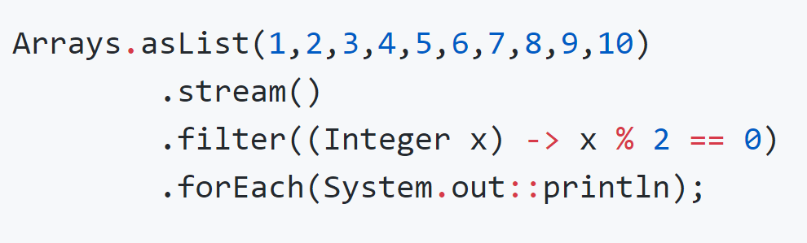
Exercises - Answers
1. Print all the even numbers in [1,10]

Slide 27
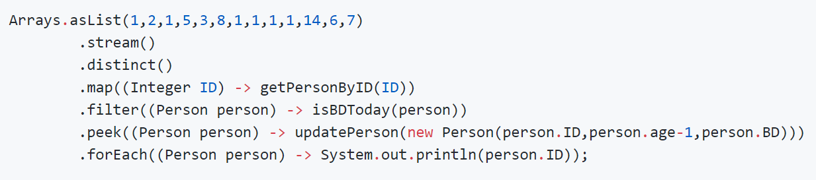
Exercises - Answers
2. Given list of IDs (not distinct IDs), get each Person object related to that ID from a server, if his B.D is today then update each age to age+1. Print the Ids of the person you updated their age.

Slide 28
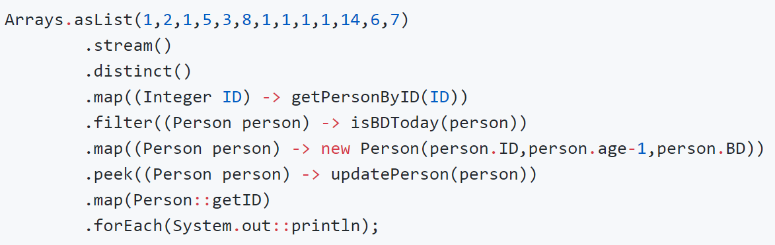
Exercises - Answers
2. Given list of IDs (not distinct IDs), get each Person object related to that ID from a server, update each age to age-1 only if his B.D is today. Print the Ids of the person you updated their age.

Slide 29
Coming next…
Primitive streams
Optional class
Reduction
Collectors
Spliterators
Parallel streams

